Slide 1
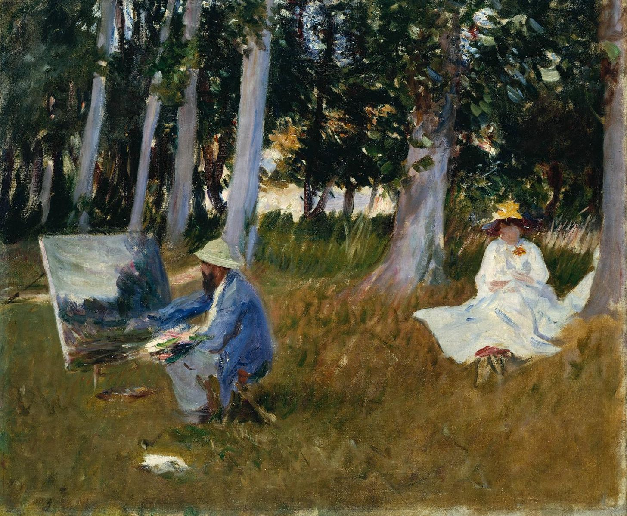
THE AMERICAN COLONY AT GREZ-sur-LOING by
Michel Schulman
With the Contribution of the City of Grez- sur-Loing
Design : Georges Levet

Slide 2

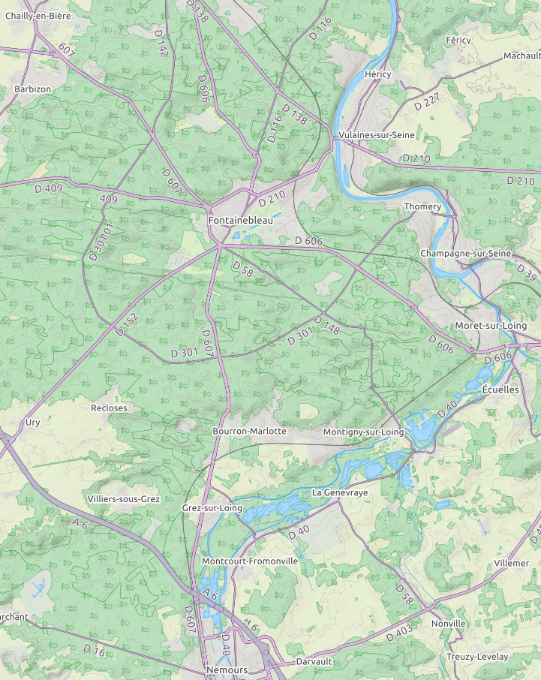
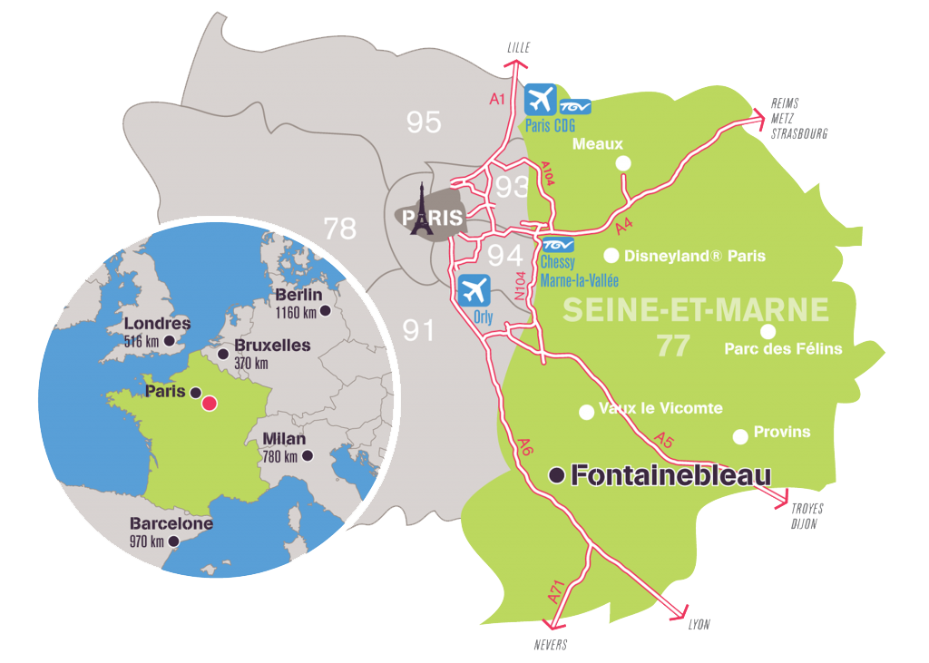


Barbizon
Grez-sur-Loing
Thomery
Fontainebleau
Moret
sur-Loing
Bourron
Marlotte
Montigny
sur-Loing
Grez-sur-Loing
GREZ-SUR-LOING
Nemours

Slide 3
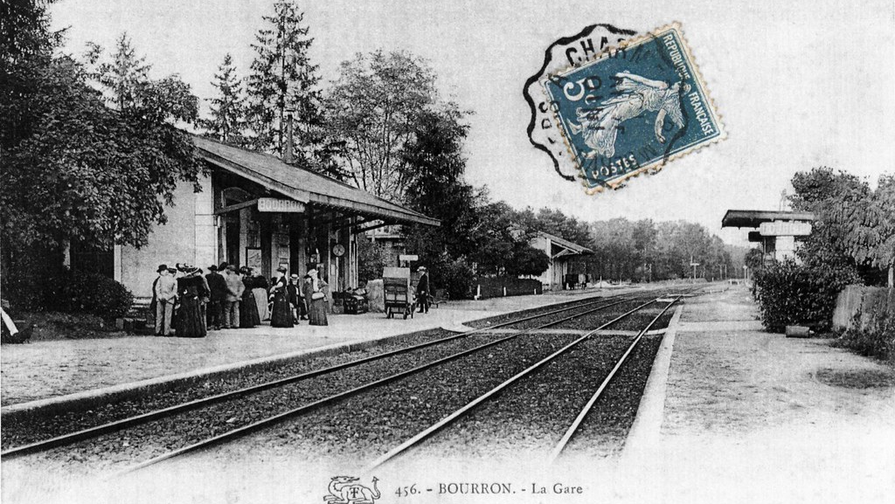
Bourron-Marlotte : the railway station in 1860

Slide 4
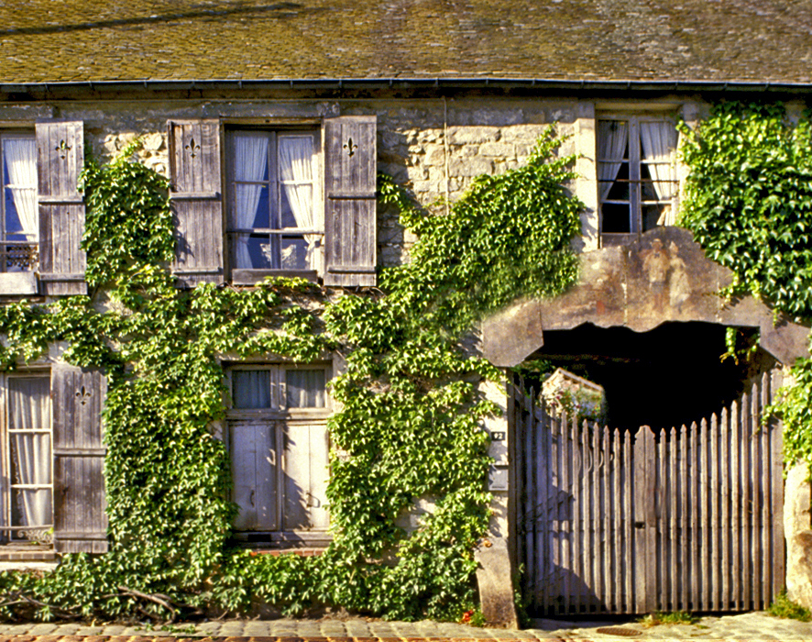
AUBERGE GANNE BARBIZON in 1976 before restoration
« Songe à Barbizon ! Cette histoire est sublime » (Vincent Van Gogh)
Musée départemental
Seine-et -Marne

Slide 5
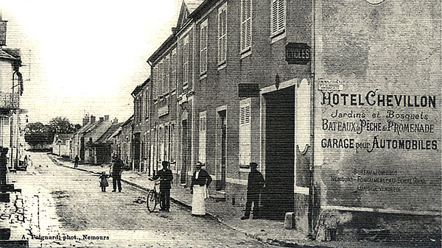
The main street of Grez-sur-Loing
At the end of the 19th Century
Notes:
0’

Slide 6
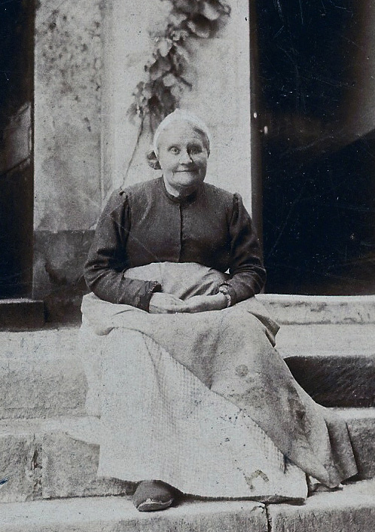
The « Mère Chevillon »
The owner and « mother to the artists »

Slide 7
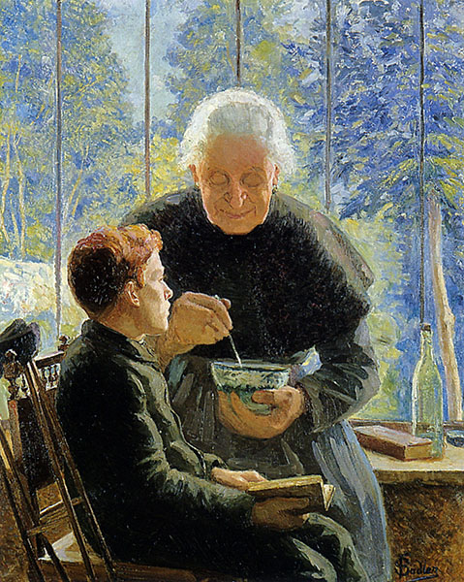
“Mère Chevillon” preparing an herb tea for an artist by Fernande Sadler
Grez-sur-Loing
City Museum

Slide 8
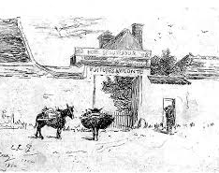
The « Pension Laurent » in the 1870’s by Elisa Greatorex.
Unique known document representing the Pension Laurent (former Hôtel Beauséjour)

Slide 9
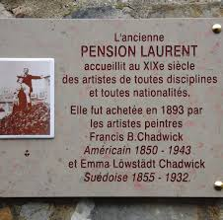
In memory of the artists who stayed or lived there in the 19th century
Opened in 1878
Francis Chadwick lived there until he died in 1943
Plaque applied to the facade

Slide 10
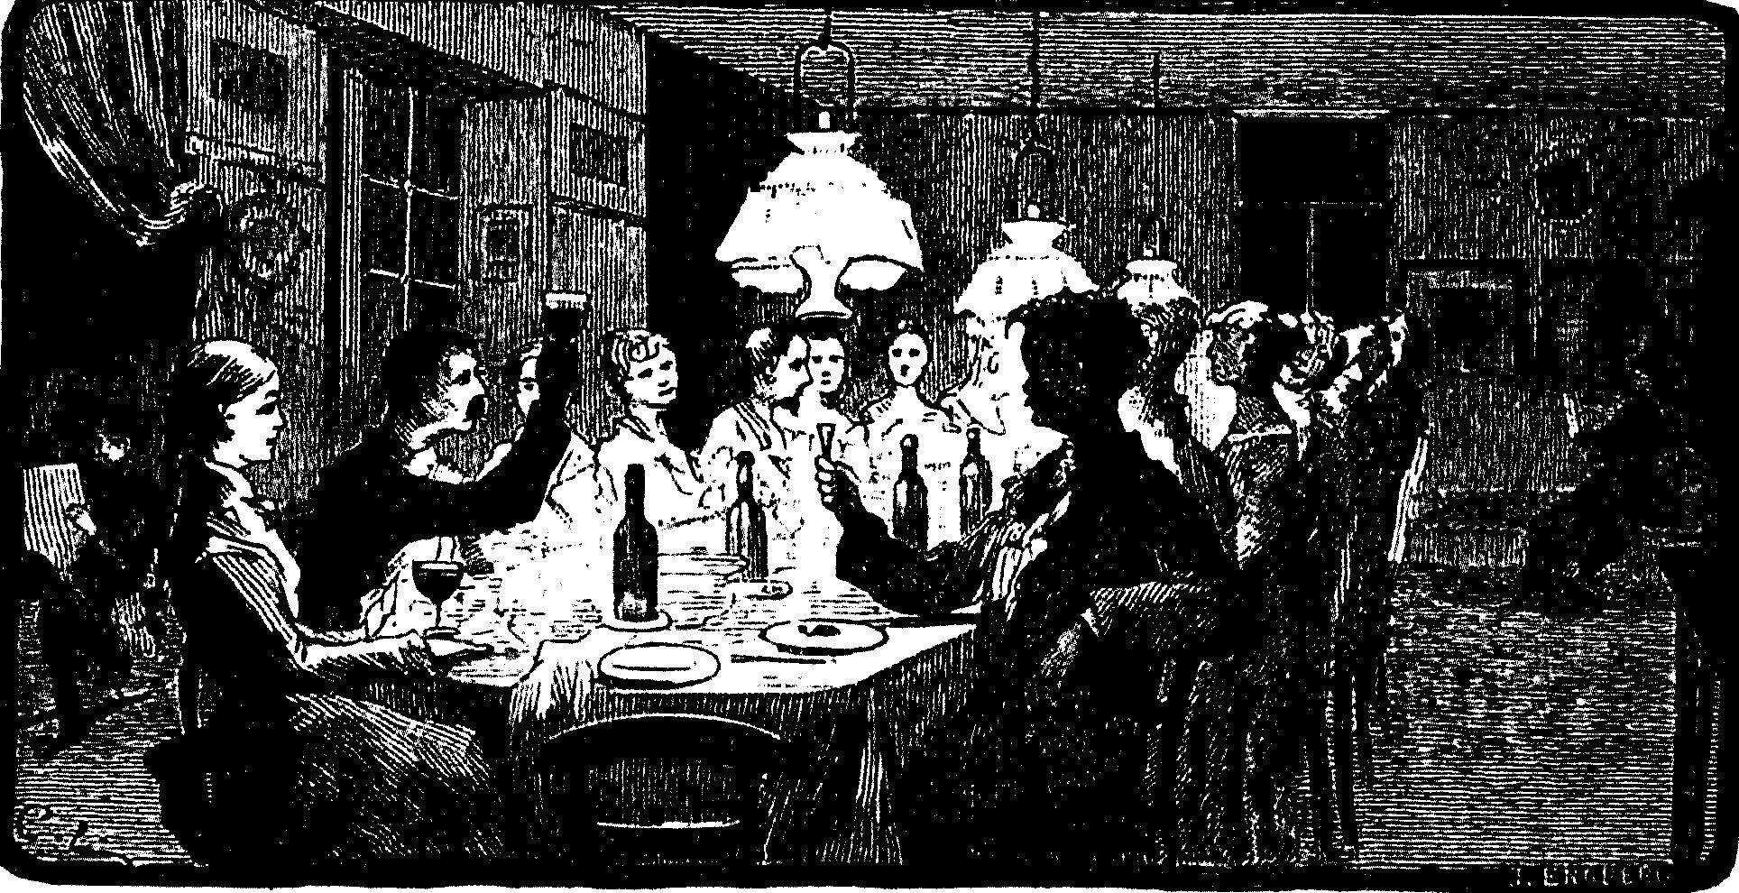
A dinner party between artists at Chevillon’s

Slide 11
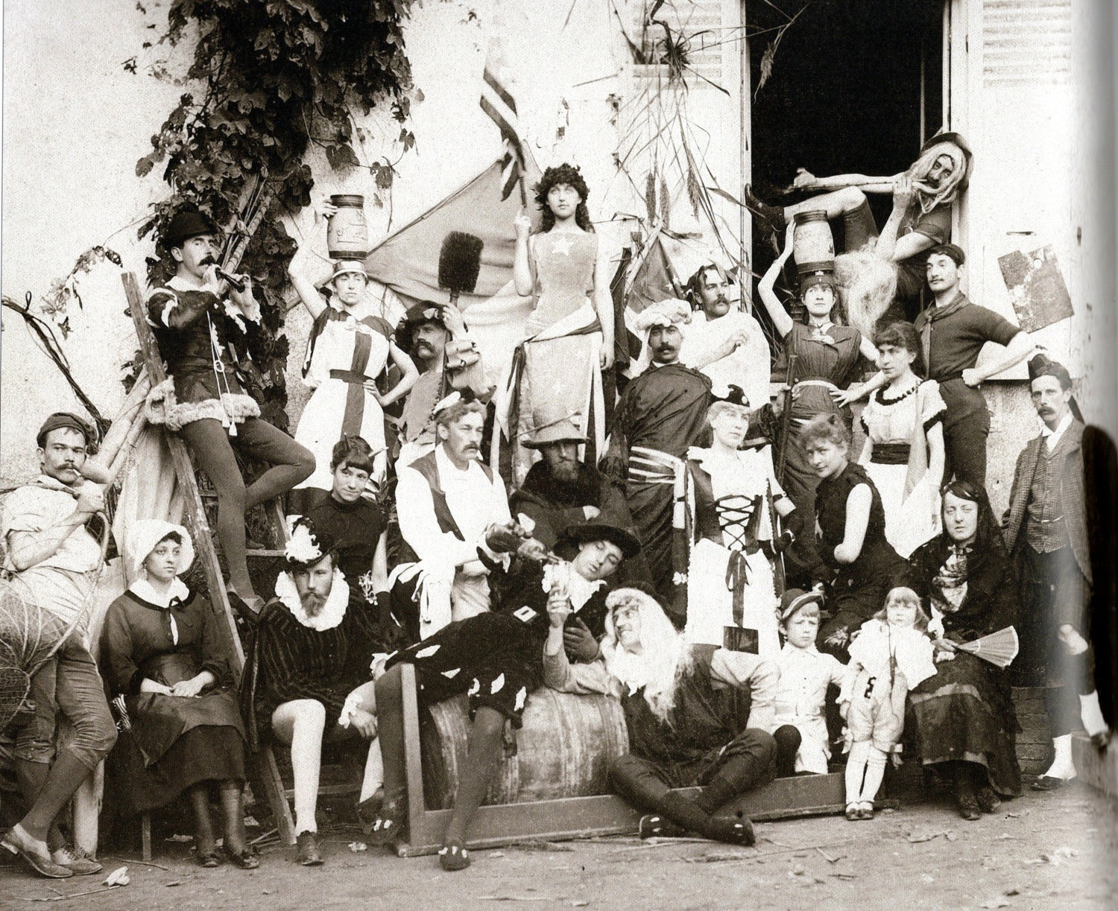
A group of costumed artists having fun !

Slide 12
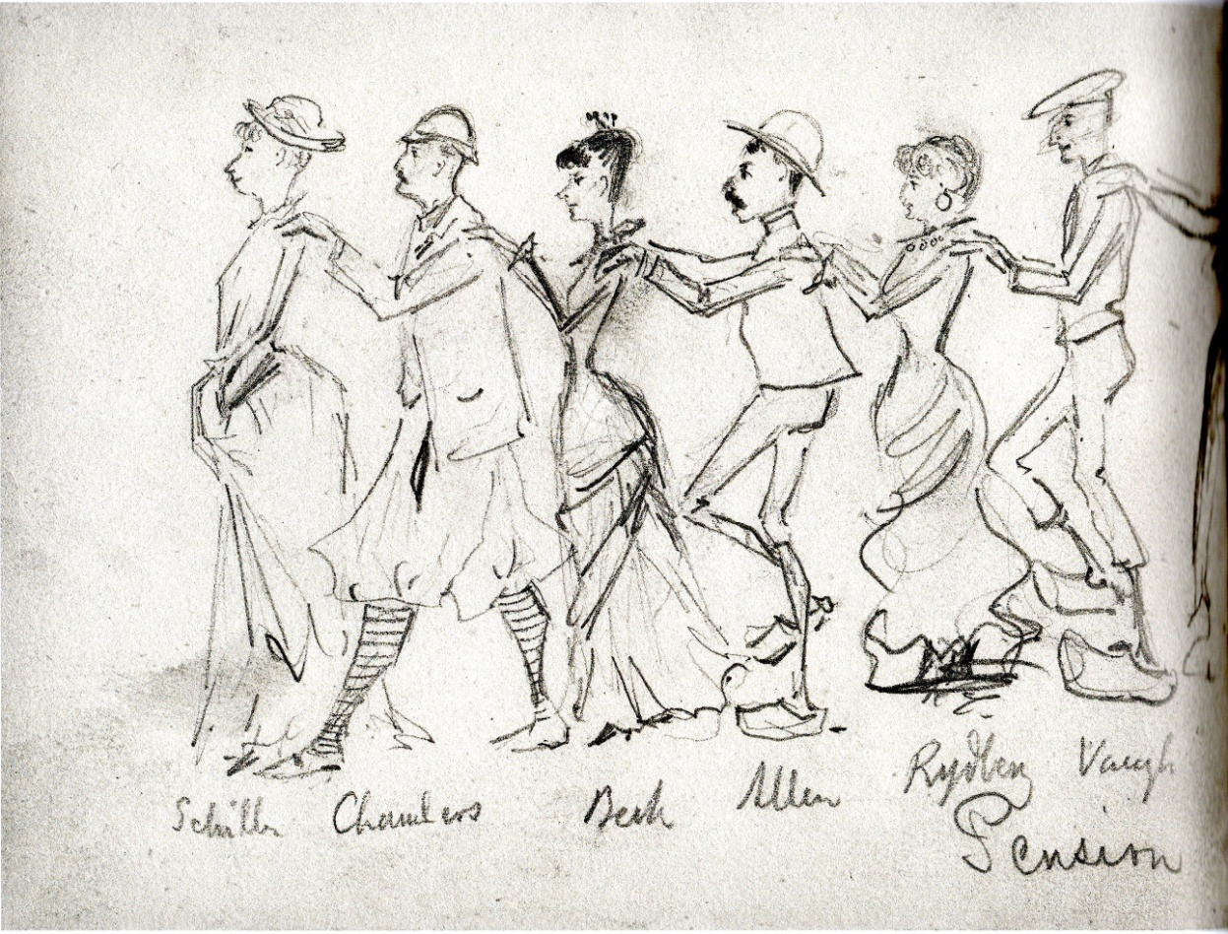
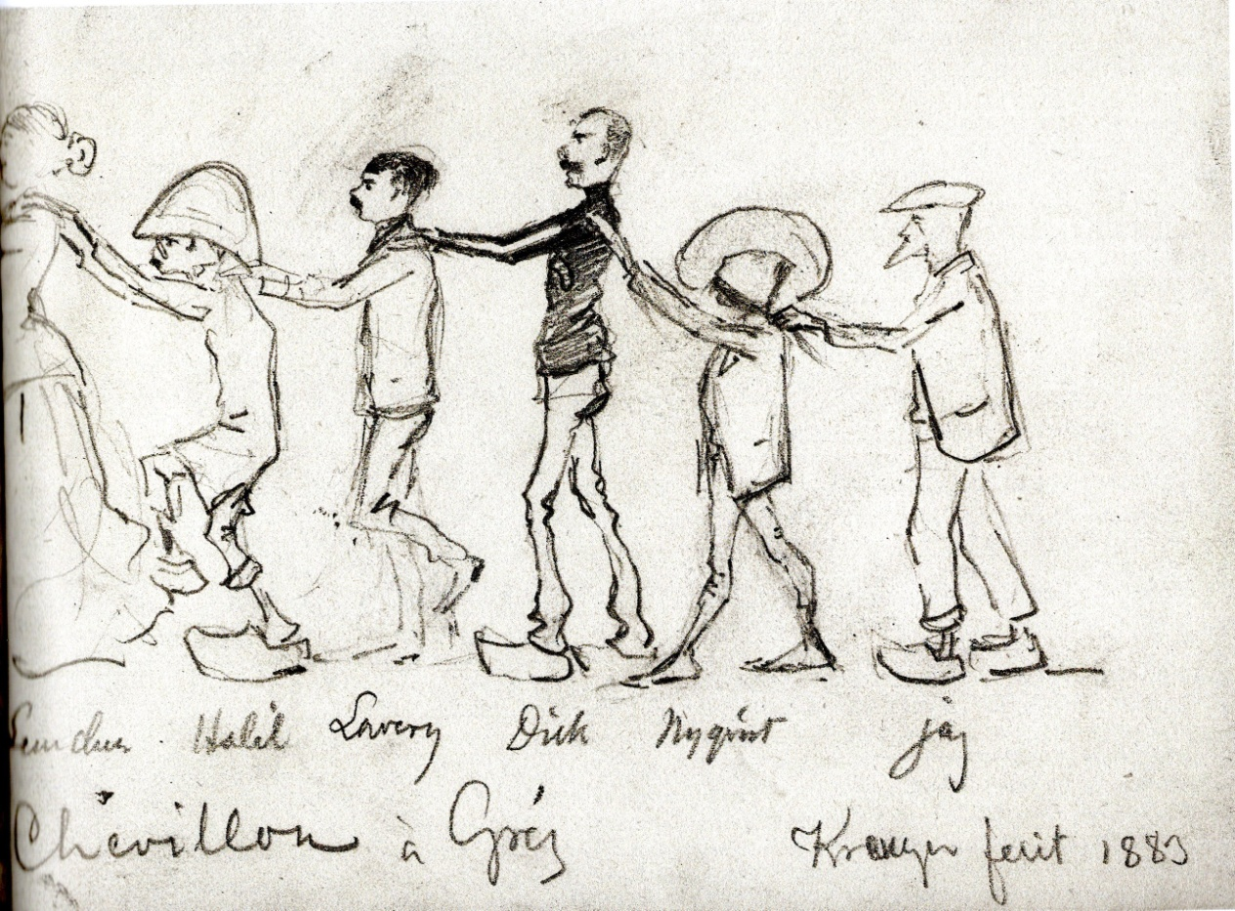
An evening party at the « Pension Chevillon » in 1883

Slide 13
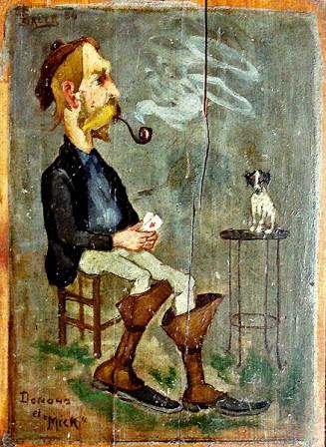
Caricature by
Gaines Ruger Donoho with the dog Mick.
Painted on a wooden panel coming from the hotel Chevillon (1881)
More than 200 paintings or sketches had been done on the walls of the hotel.

Slide 14
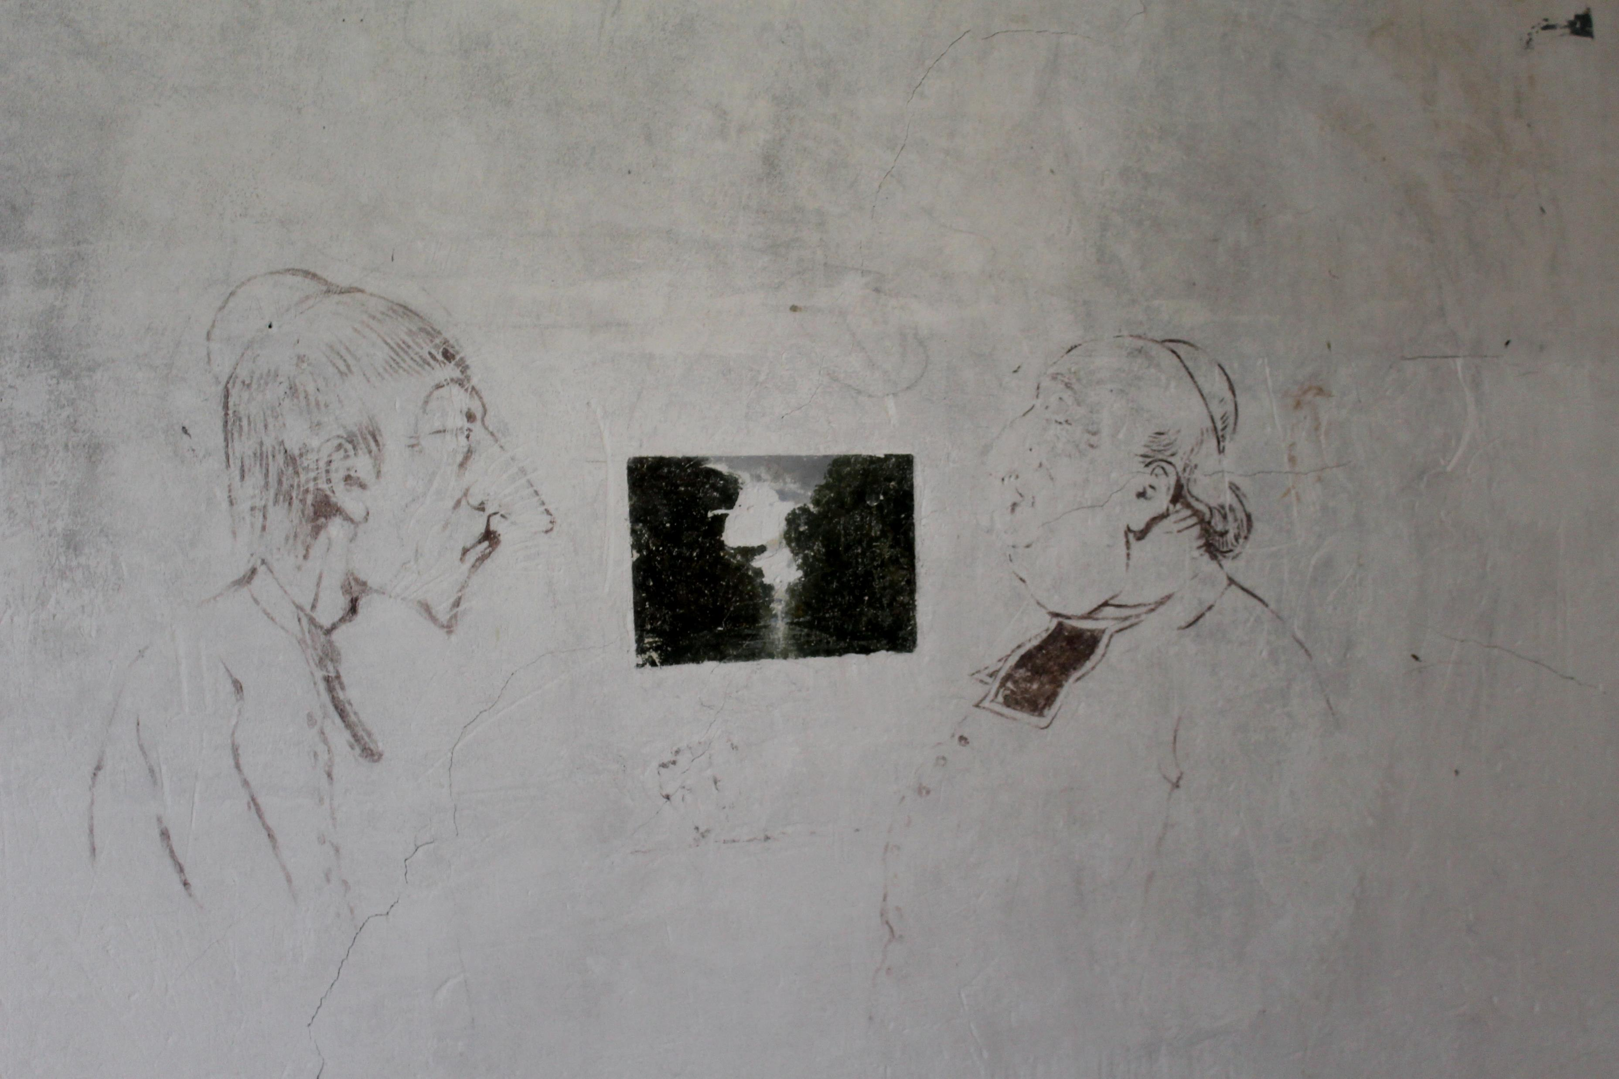
A caricature found on the walls of the“Auberge Ganne”
Musée départemental de Barbizon

Slide 15
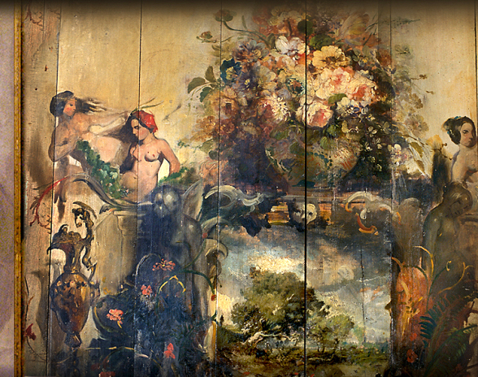
Painting on a wooden panel from « Auberge Ganne » Barbizon around 1860
Here, from 1830 to 1870, young artists have changed the history of painting…
Musée départemental Seine-et-Marne

Slide 16
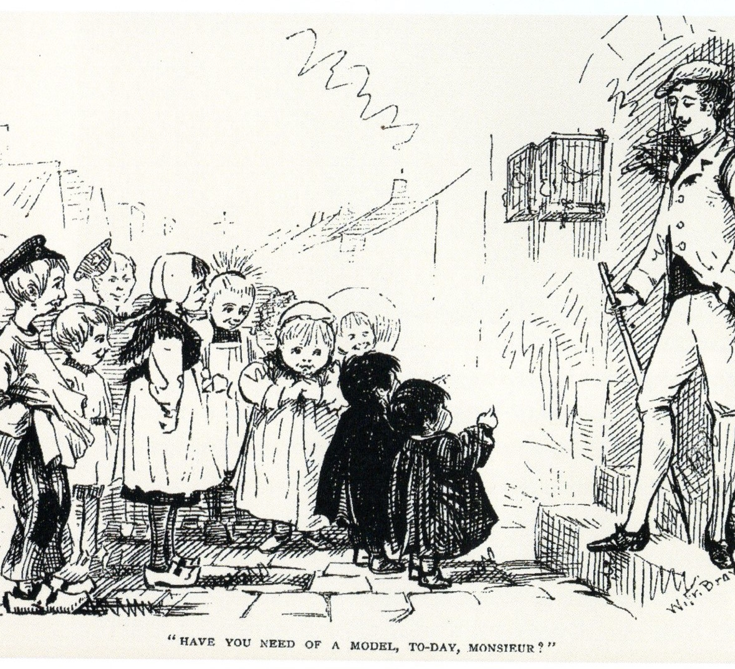
The friendly relationships between the artists and the young population

Slide 17
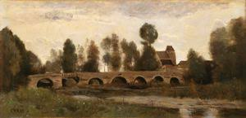
The old bridge of Grez-sur-Loing by Corot in 1850

Slide 18
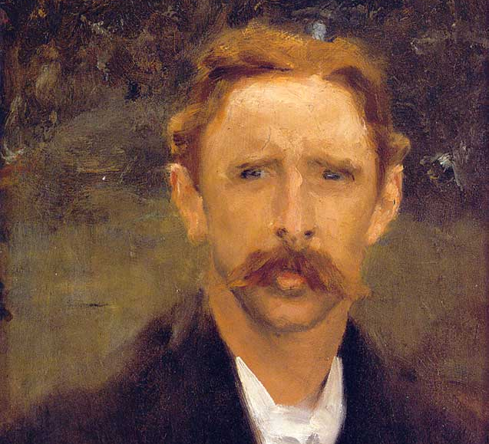
Francis Brooks Chadwick
(Boston1850 – Grez-sur-Loing 1942)
Portrait by
John Singer Sargent
Chadwick bought the
« Pension Laurent » in 1893

Slide 19
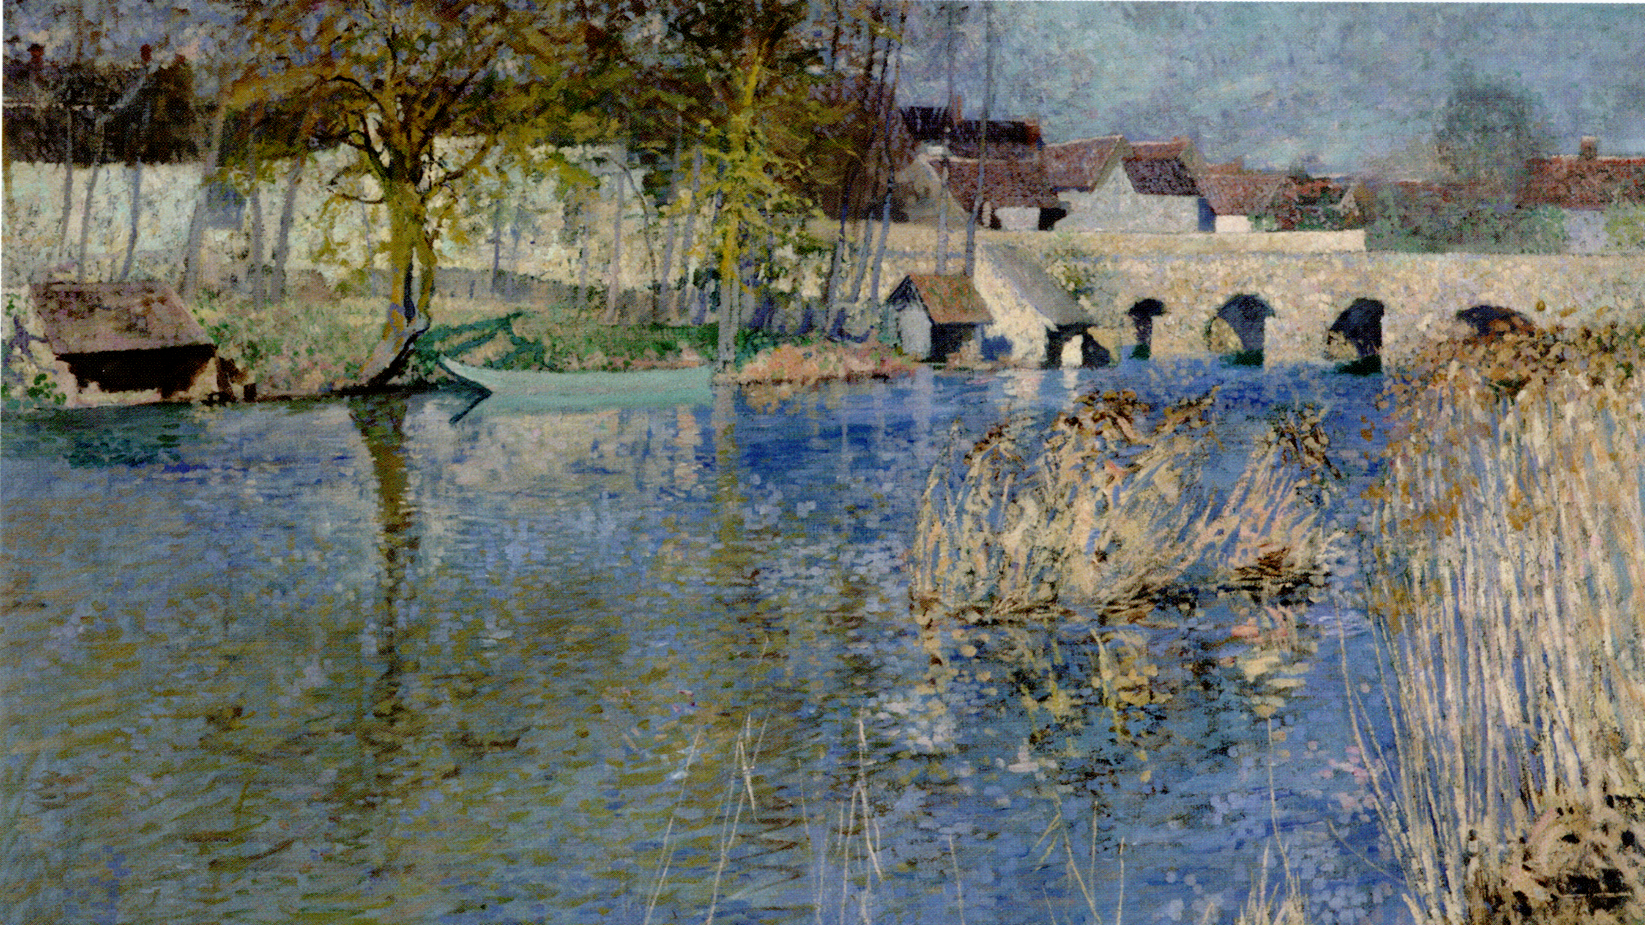
The old bridge and the city in the background by Francis Chadwick

Slide 20
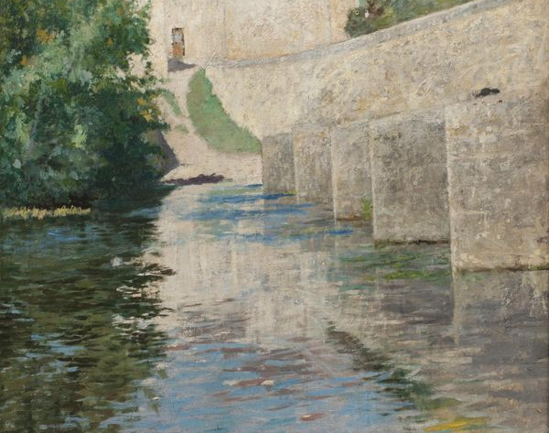
Another closer view of the bridge by
Francis Chadwick

Slide 21
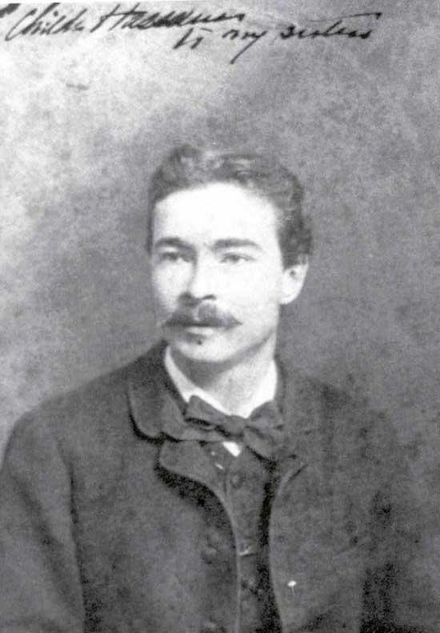
Portrait of Childe Hassam

Slide 22
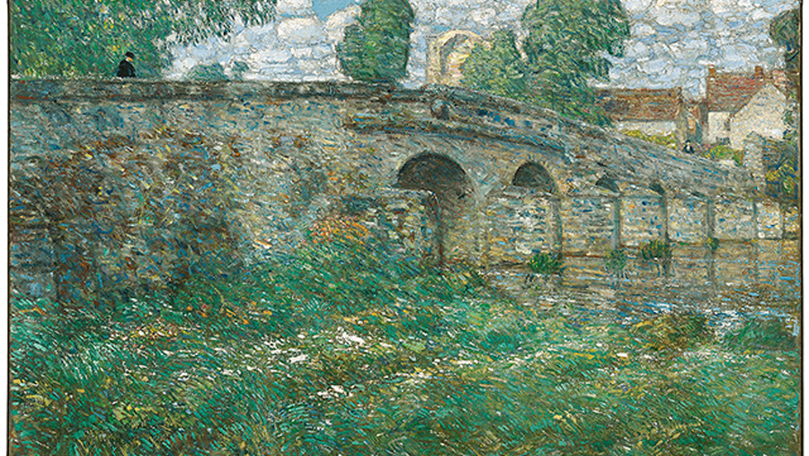
The old bridge by Childe Hassam

Slide 23
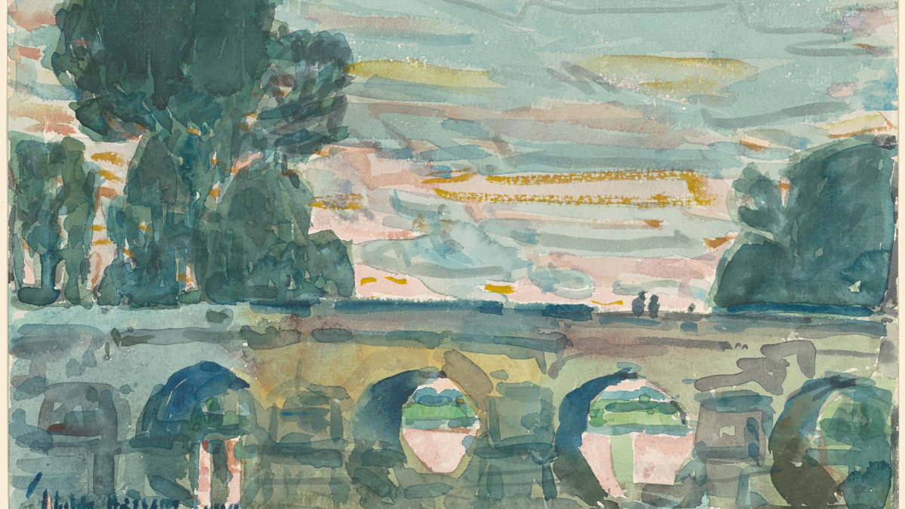
The bridge by
Childe Hassam in 1914
Watercolour

Slide 24
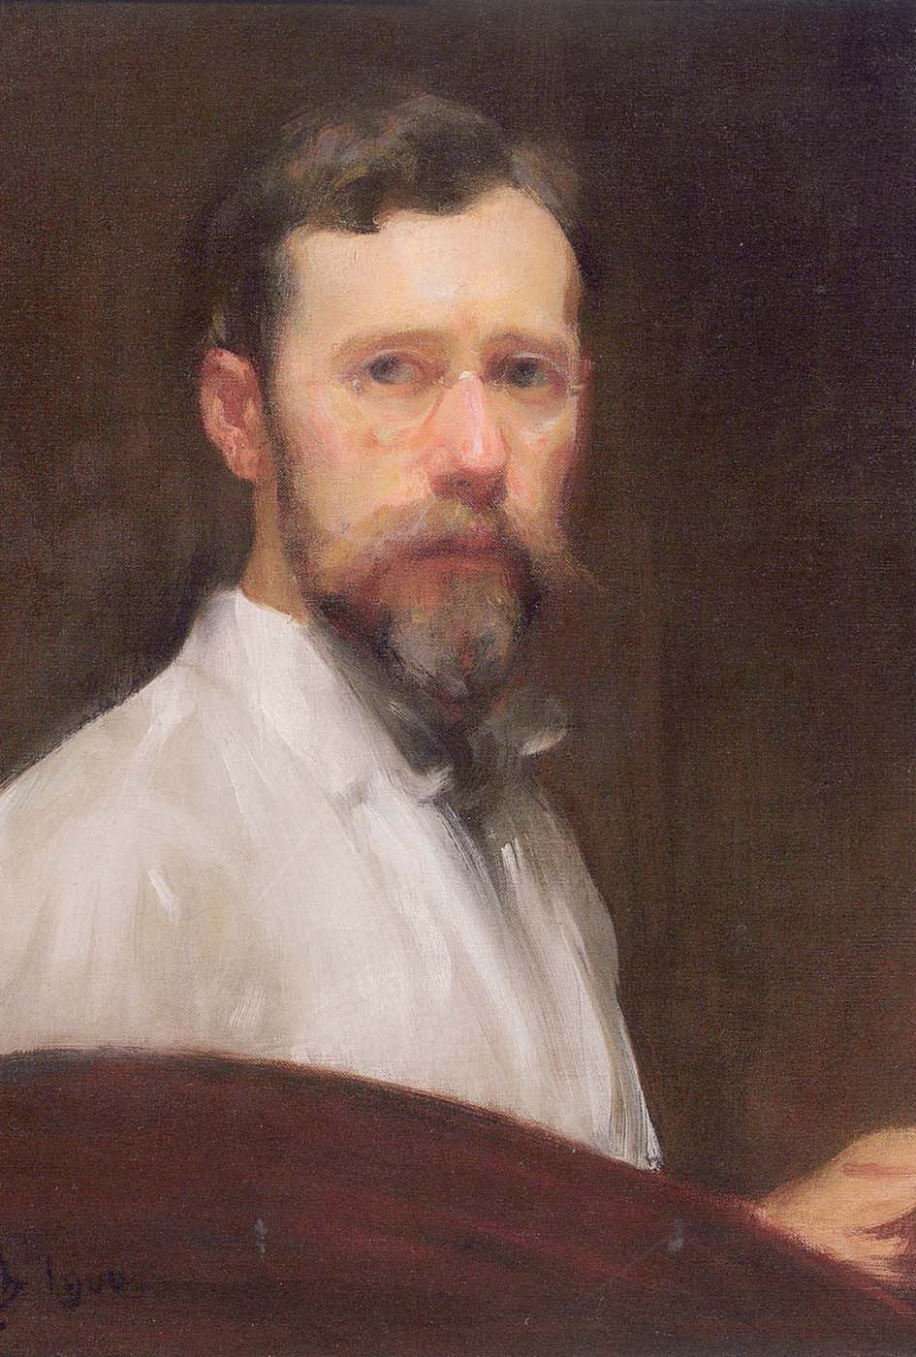
Portrait of Robert Vonnoh with a palette

Slide 25
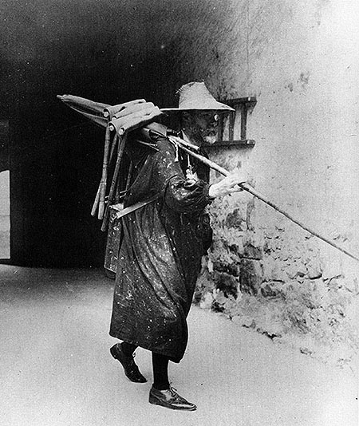
Robert Vonnoh leaving for painting in a picturesque artist equipment

Slide 26
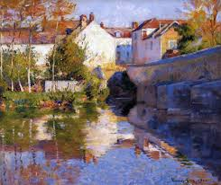
The bridge of Grez in summer
Robert Vonnoh

Slide 27
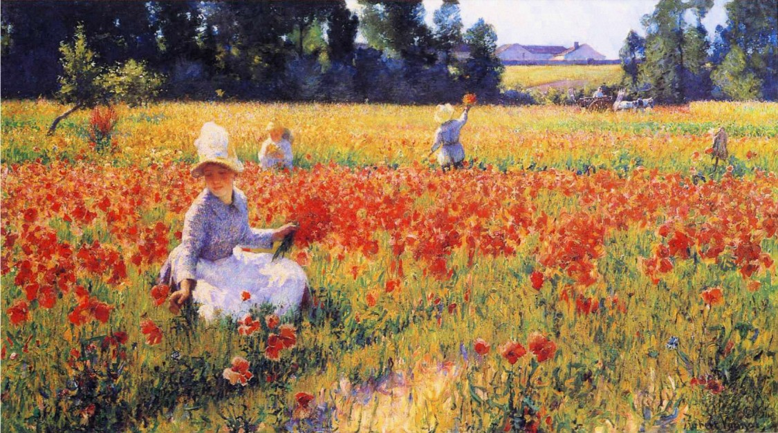
Young girls picking up poppies
by Robert Vonnoh
Coquelicots

Slide 28
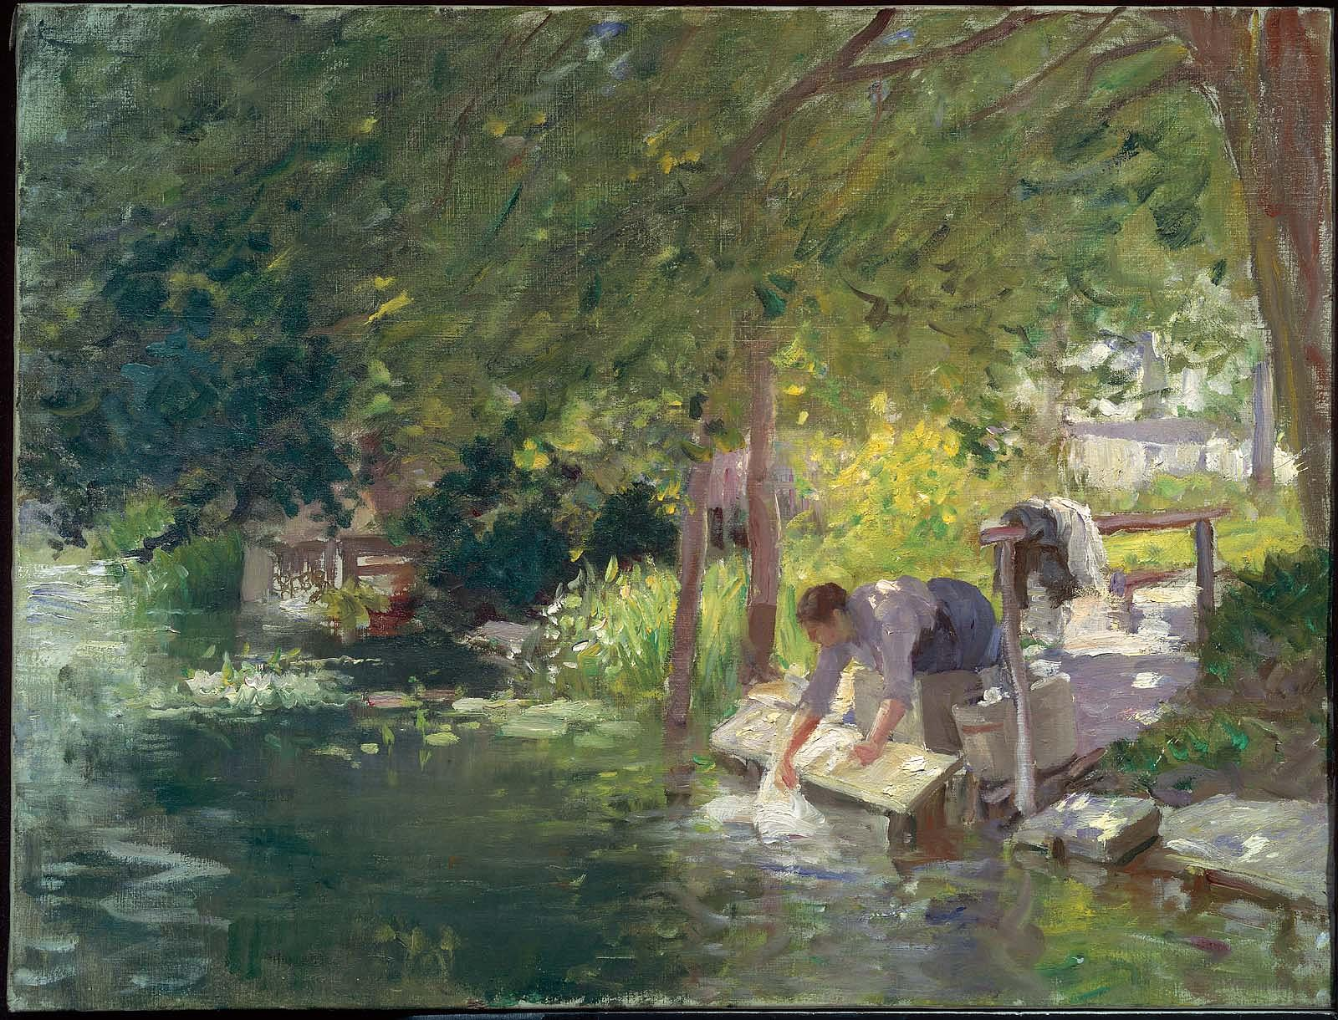
Laundress on the riverside by
Frederic Porter Vinton

Slide 29
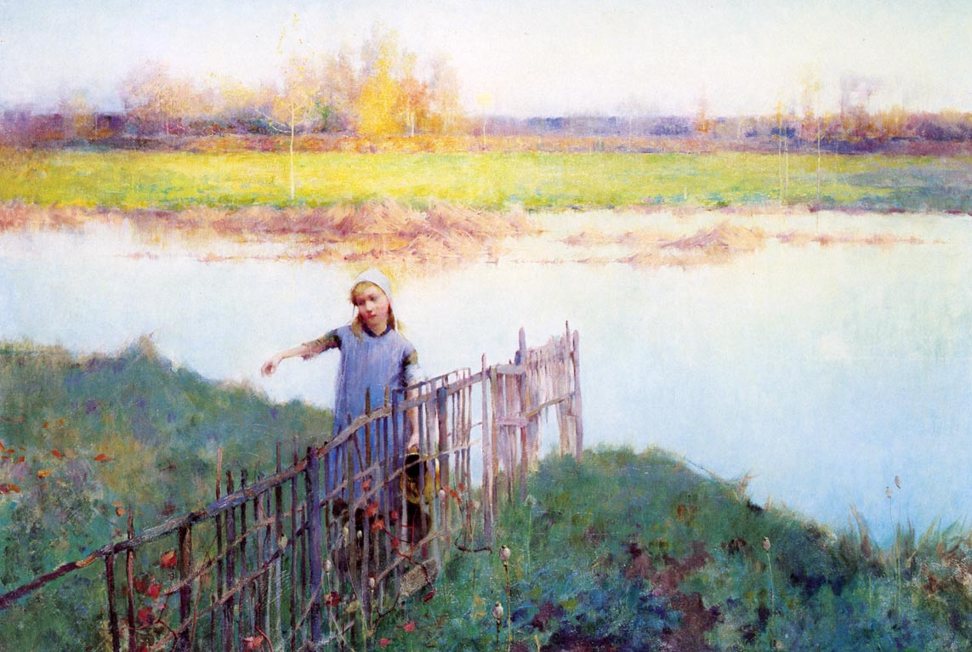
Sunset by the river by
Willard Leroy Metcalf

Slide 30
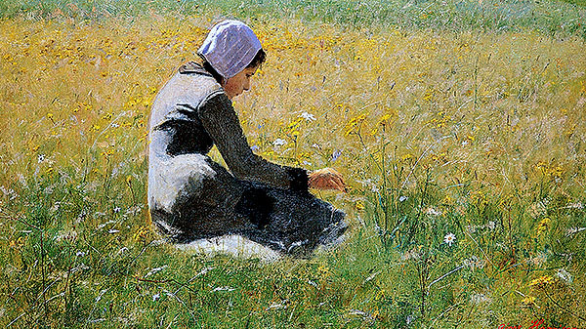
Lovell Birge Harrison : Young girl in the field

Slide 31
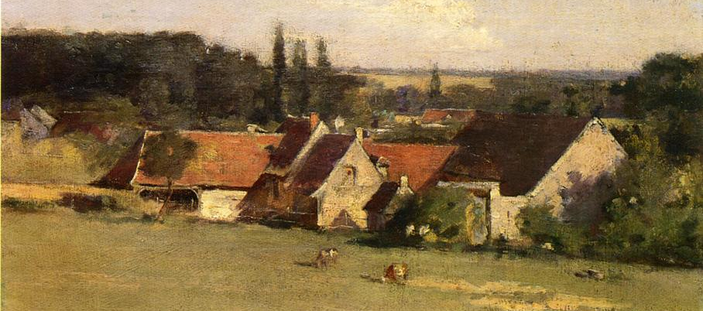
Theodore Robinson (Monet’s son-in-law) was at Grez-sur-Loing in 1877
Here : Farmhouse in Grez

Slide 32
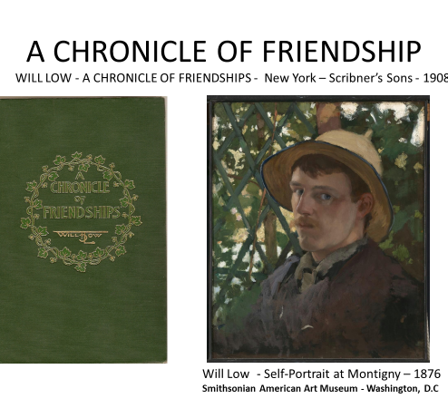
Some reminiscences
A Chronicle of Friendships, 1873-1900 (1908) by Will Low, a close friend of Stevenson

Slide 33
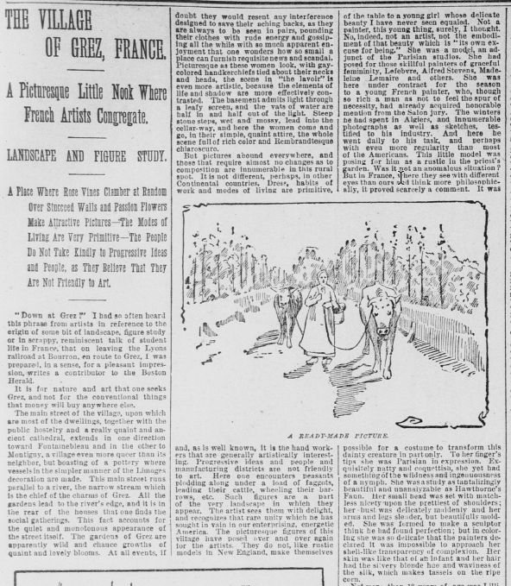
A press article dated April 1891describing Grez-sur-Loing
The Morning Call -San Francisco

Slide 34
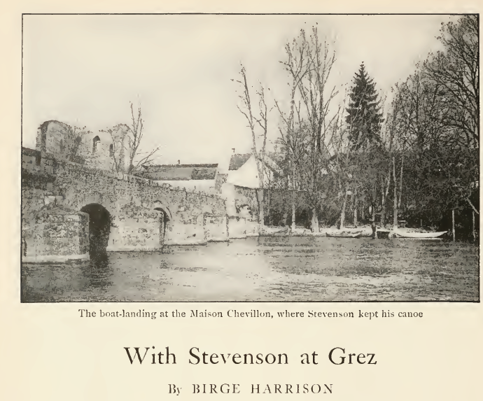
WITH STEVENSON AT GREZ
Birge Harrison - « With Stevenson at Grez « - Century Magazine , December 1916

Slide 35
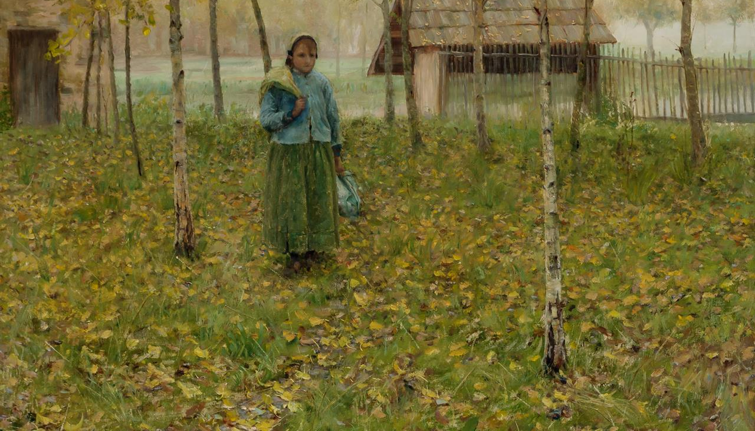
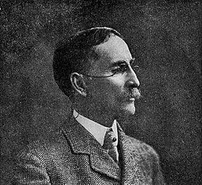
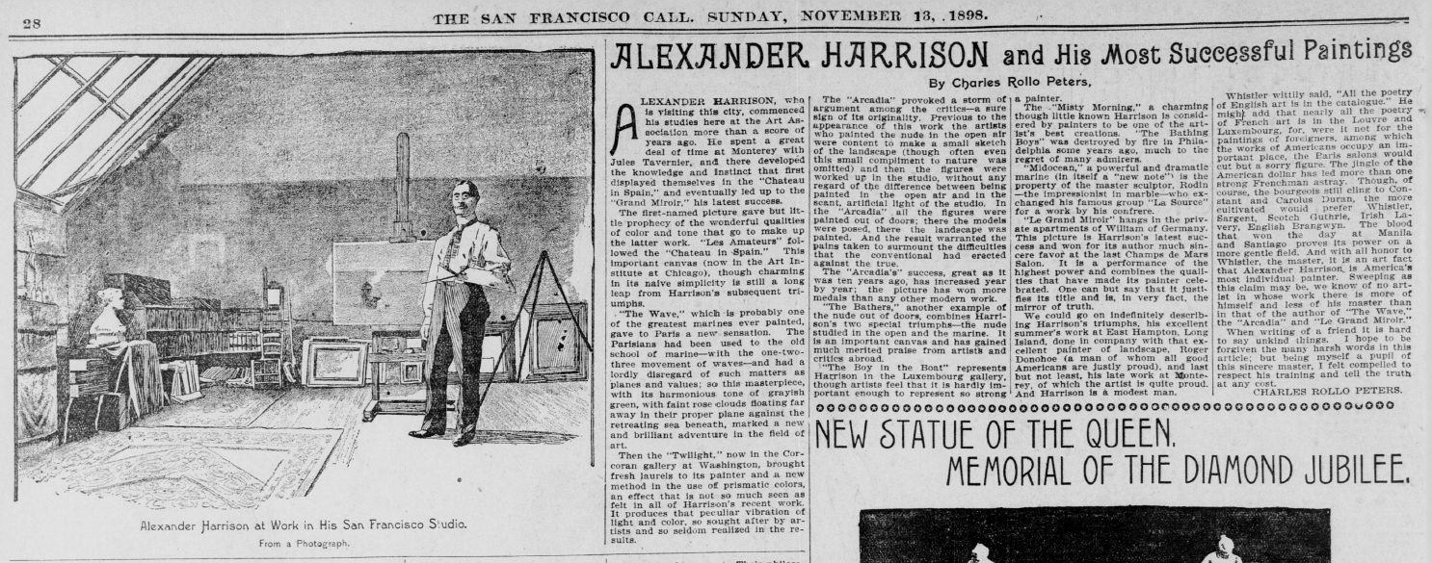
« Harrison and his most successful paintings »

Slide 36
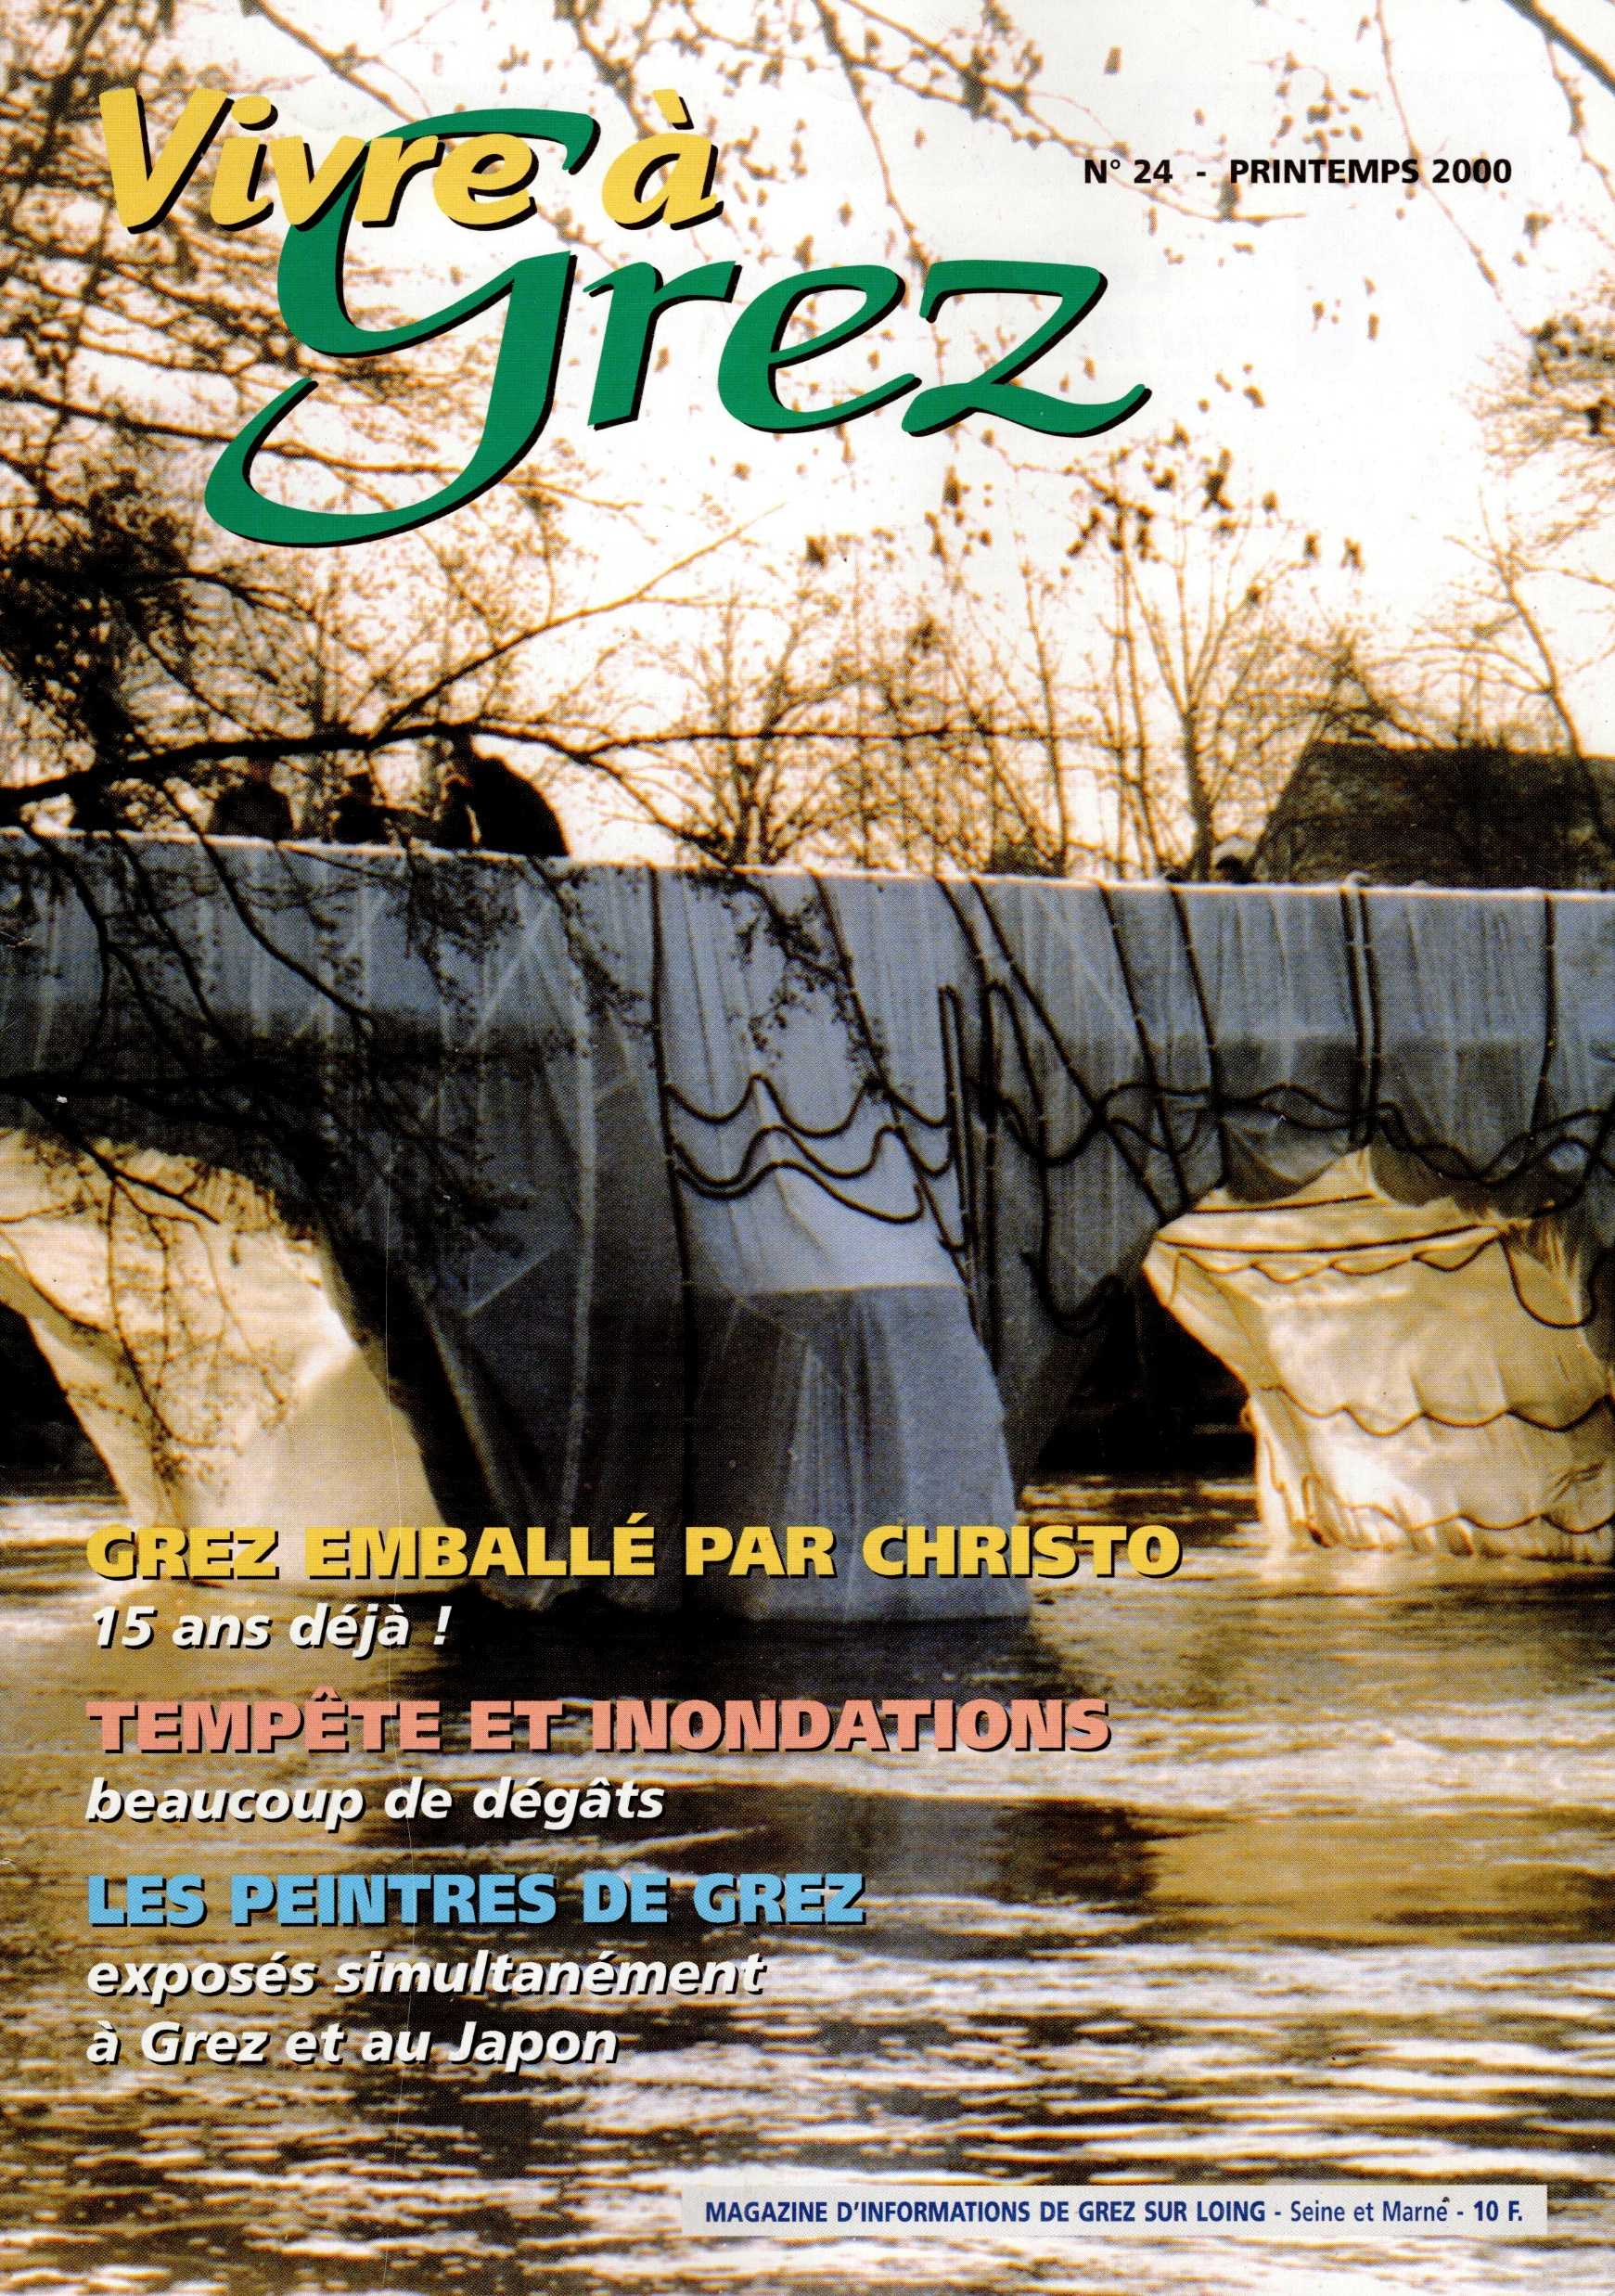
The Old Bridge of Grez wrapped by Christo in 1984 - Pont-Neuf in Paris in 1985
Photo dated 2000 – Grez-sur-Loing municipal magazine

Slide 37
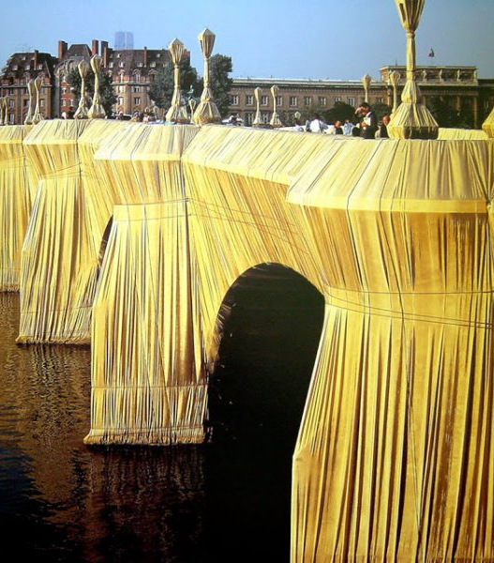
CHRISTO : The « Pont Neuf » in Paris, wrapped by Christo in 1985.
Will probably be done again in April 2020 !

Slide 38
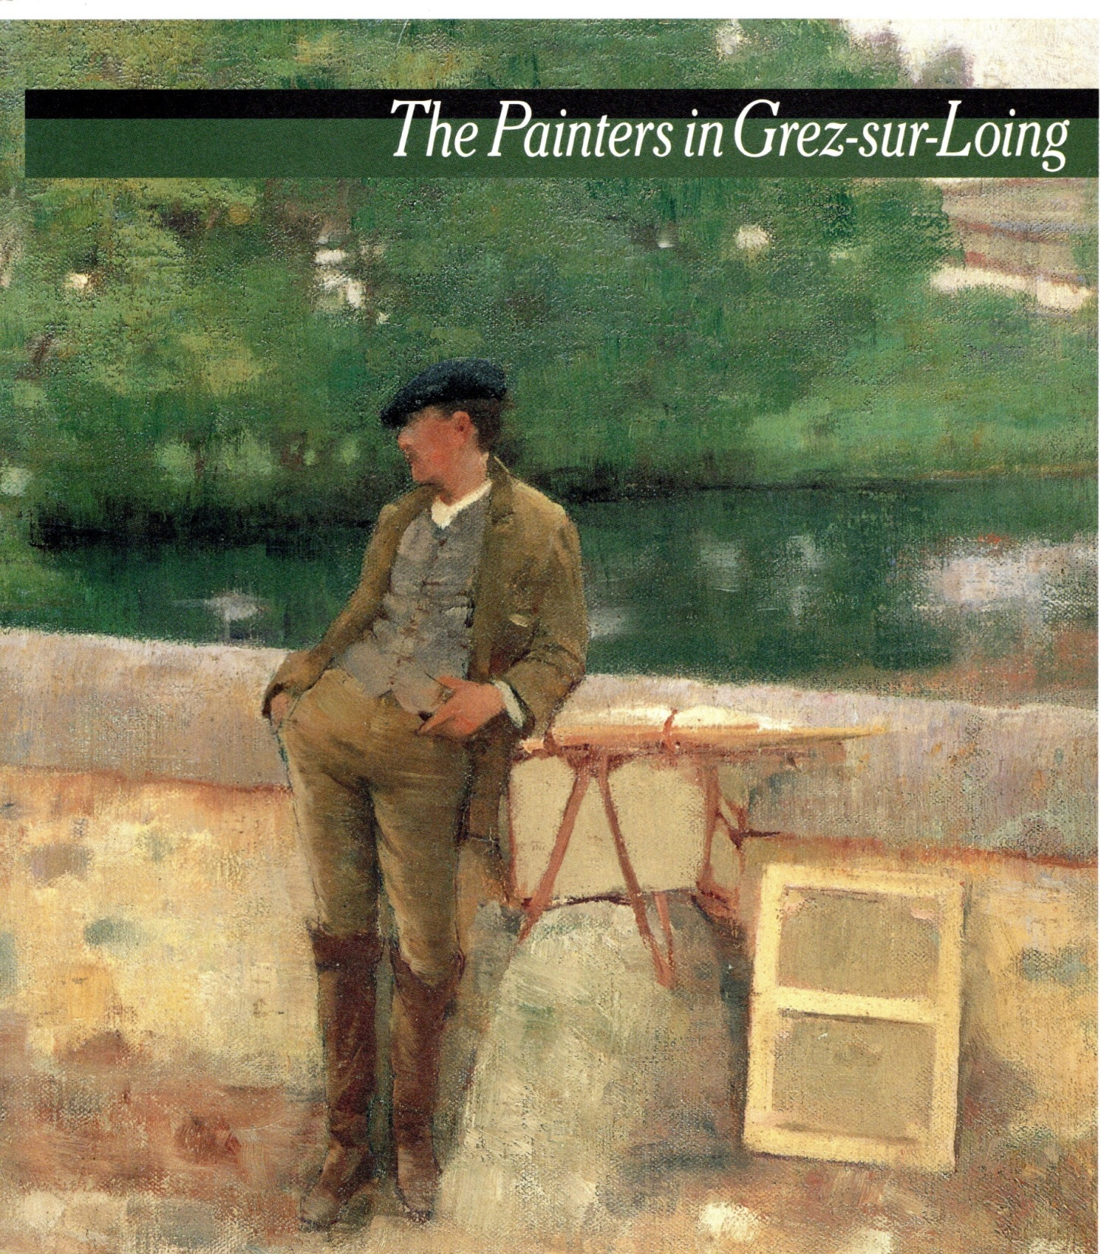
Venez à Grez, Venez à Grez !
The slogan spread in all the artists studios in Paris at the time
Especially at the Julian Academy…

